Slide 1
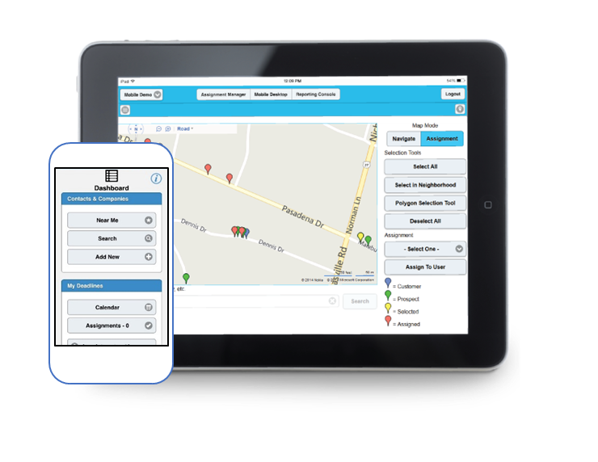
Product Overview

Slide 2
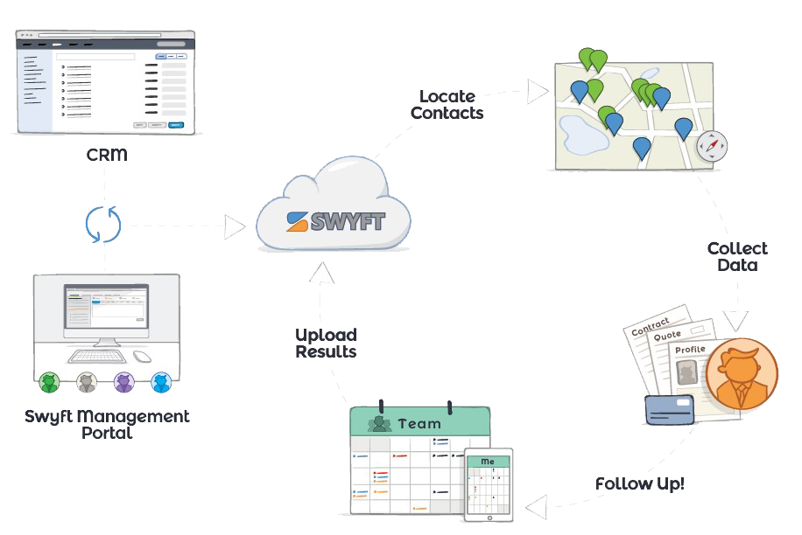
What is SWYFT Mobile?
Custom Configurable Mobile Solution
Integrates with various CRMs
Features for Mobile & Back Office
CRM Access
Scheduling & Calendar Views
Workflow Automation
Mobile Forms
Mapping
Geographic Assignment
Photo Capture

Slide 3
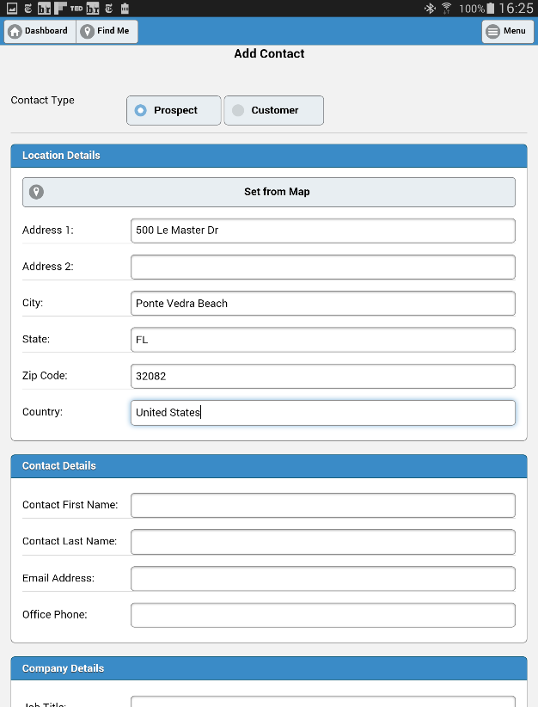
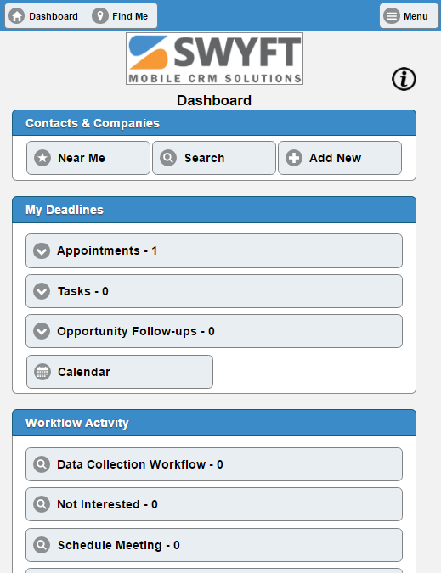
Dashboard
Easy-to-use mobile friendly main view
Find the right prospects/customers
Search
View Near Me from map
All-in-one view of entire day’s Deadlines
Appointments
Tasks
Opportunities
View results from your custom configured Workflow Activity

Slide 4
Add Contacts
Auto-populate address from a map view
Configure required and optional fields
Input to custom fields
Trigger campaigns and action sequences

Slide 5
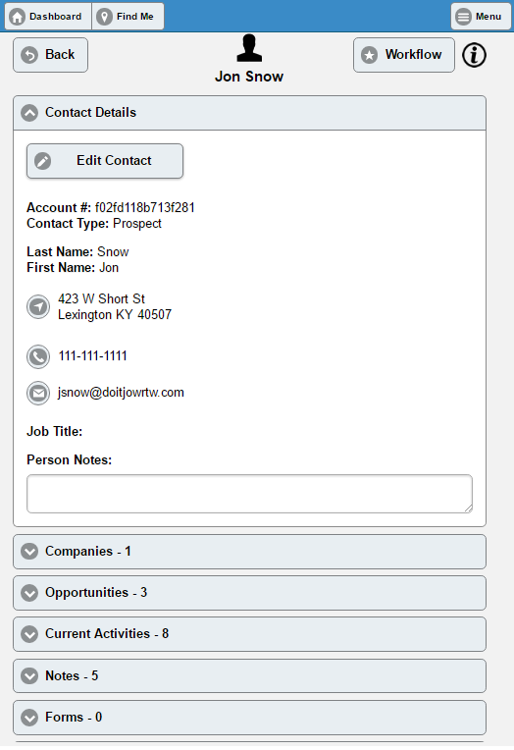
Manage Contacts
Search contact list
View and edit
Contact details
Opportunities
Appointments
Tasks
One touch call and email
One touch navigation
Update person notes

Slide 6
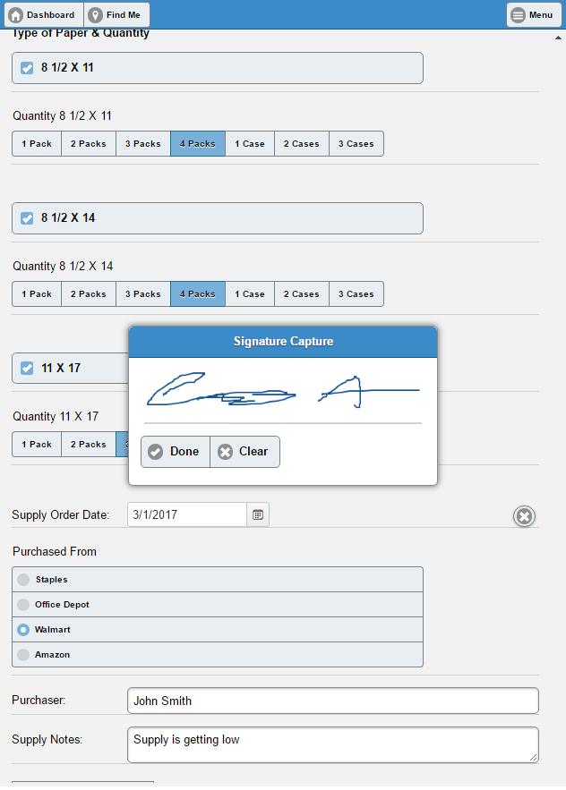
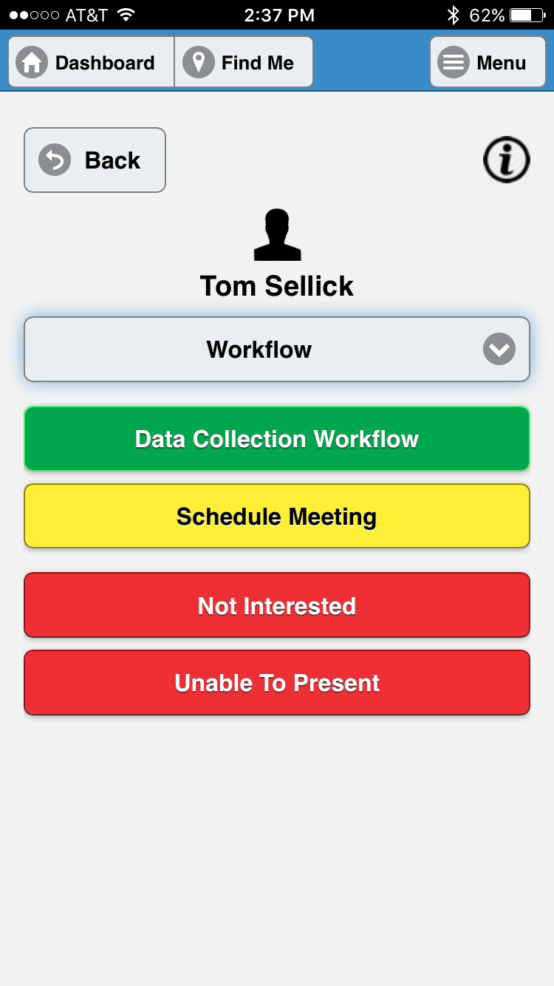
Workflow & Mobile Forms
One-Touch Automation
Outcomes Mapped out by Interactions and Results
Custom Reports
Mobile Friendly Forms
PDF Generation and Distribution
Automatic Notification
Schedule Follow-Ups and Fulfillment while in front of Customer

Slide 7
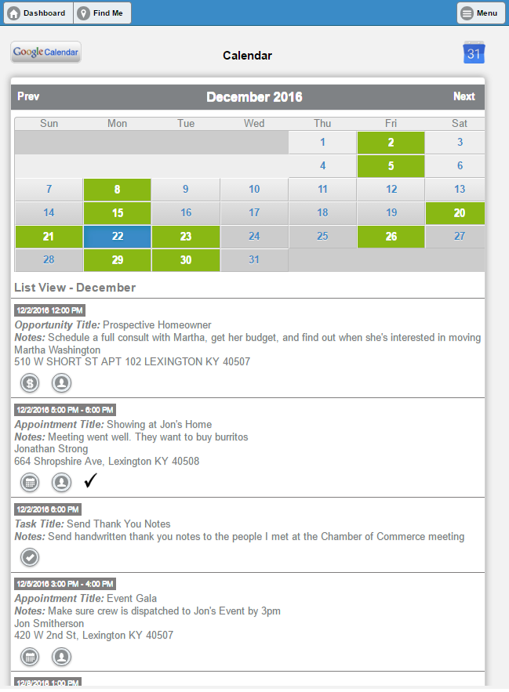
Activity Calendar
Color-coded calendar view
Quick glance consolidates
Appointments
Task deadlines
Opportunity follow-ups
Record completion, results and follow-ups

Slide 8
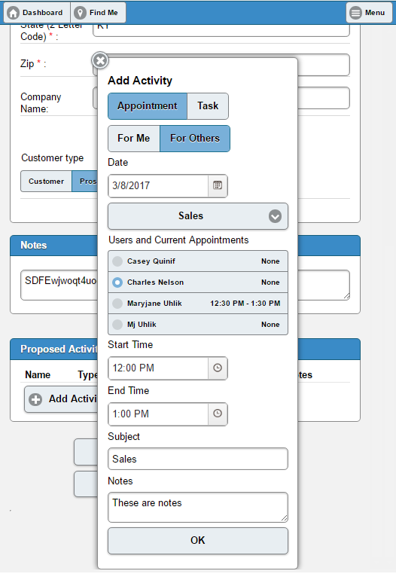
Team Scheduling
Advanced scheduling by:
Team
Skill set
Appointment Type
Availability
Notifications to
Customer
Team Members

Slide 9
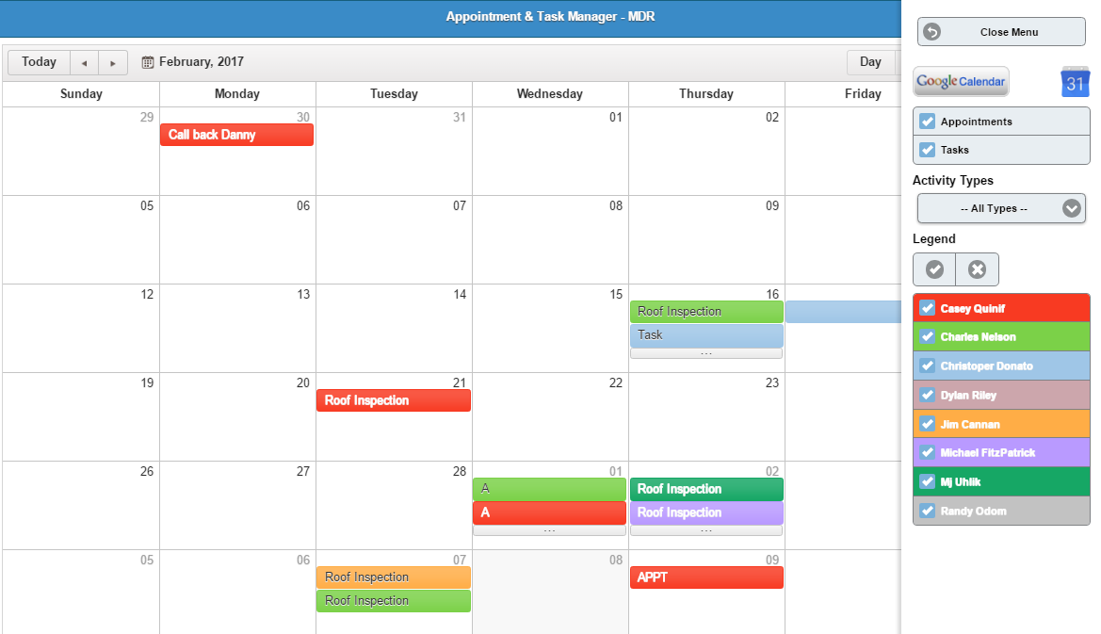
Team Calendar
Consolidated Appt & Task Manager
Create, edit, reassign
Entire team at-a-glance
Sort by teams
Week, Day, Month, Timeline views
Automated Notifications

Slide 10
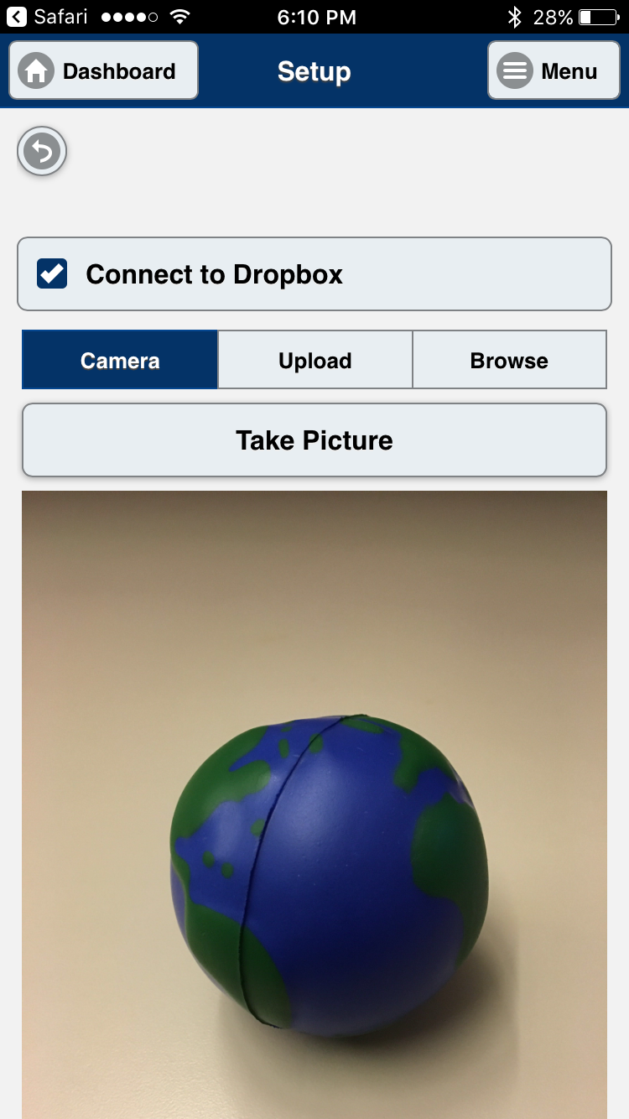
Photo Capture and Upload
Link Photos to Contacts or Companies
Automatic upload to Dropbox
Options to
Rename image file
Create Subdirectories

Slide 11
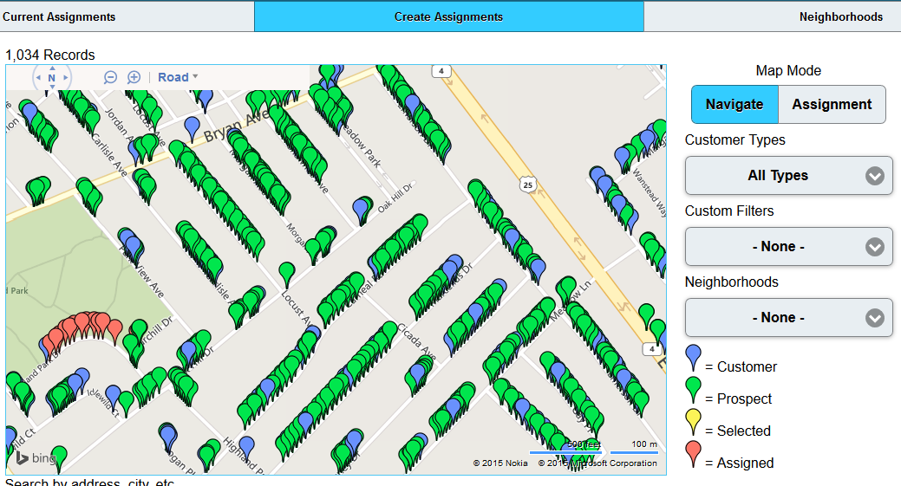
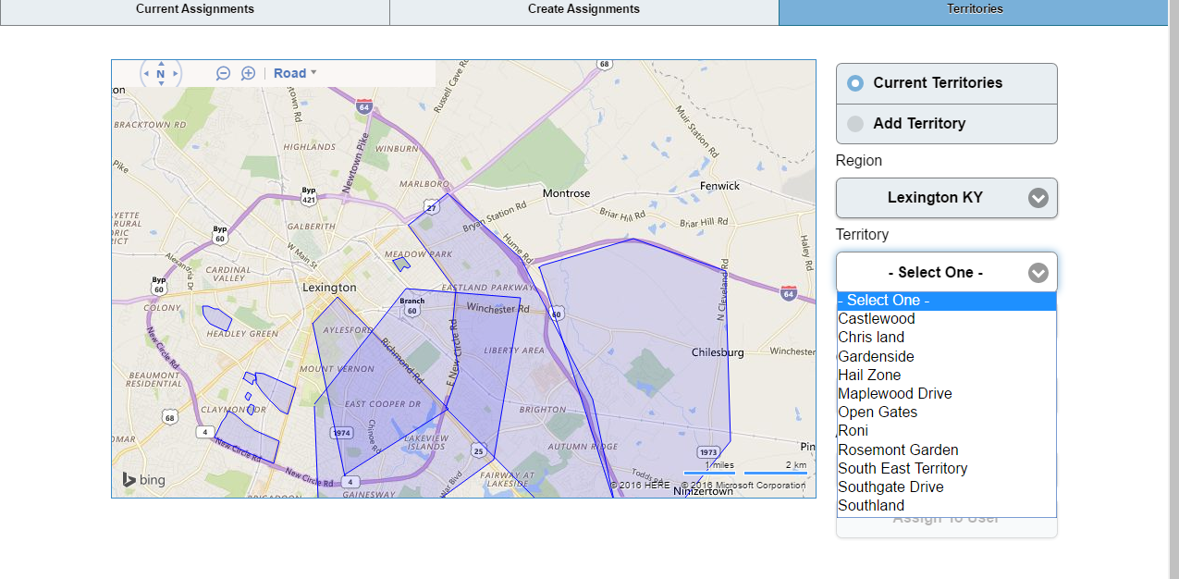
Management Portal
Assignment/Ownership Manager
Assign prospects of customers geographically
Set territories from bird’s-eye-view
Reporting
Activity tracking, including location
Exportable to various file formats

